Slide 1
Informational Webinar:
Budget Reduction Impacts on Workforce
March 19, 2026
PRESENTED BY:
MSU Human Resources

Slide 2

Faculty and Academic Staff RIF Process
March 2026

Slide 3
Reduction In Force for FAS
Process for Reduction in Force for FAS
  Guidance Documents on FASA website
  Reduction in Force Review and Approval from FASA
    Changes to employment %
    Changes to appointment basis (AN to AY)
    Termination of appointment
  Terminations due to Federal Funding Disruptions
  RIF FASA Review Form

Slide 4
THANK YOU!
Office for Faculty and Academic Staff Affairs
Office of the Provost
fasaffairs@msu.edu

Slide 5
Support Staff Layoff Agenda
University Position Approvals
Reduction in Force and Layoff Definitions
Initiating a Layoff
MSU HR Review and Approval
Notice of Layoff
Best Practices for Issuing a Notice
Notice Periods per Union Group
Administrative Leaves – Layoff Notice
Unit Considerations: Accruals and Payouts
High Level Overview of Layoff Bumps versus Non-Bumping Layoffs
Form & Workflow Reminders
Hiring Pause
Support Staff Virtual Office Hours

Slide 6
University Position Approvals
Reminder that in 2025, HR automated the MAU Authorized Signer list and delegates on the Academic Position Request Form and the Support Staff Posting Request Form.
Approval steps for position approvals will reside with the President’s Office, EVPA Office, Provost Office and Health Sciences Office based on the units reporting structure.
  President’s Office: Amanda Goll OR Mike Zeig
  EVPA Office: Vennie Gore OR Kelly Pung
  Provost Office: Ashley Green OR Ryan Thelen
  *Health Sciences: Norm Hubbard OR Georgette Russell OR Laura Kuczajda OR Karen Crosby
*The Provost or President will approve following the Health Sciences approval depending on the applicable unit reporting structure.

Slide 7
Reduction in Force and Layoffs
A reduction in force (RIF) occurs when a position is eliminated and results in a permanent cut in headcount. An employer may decide to reduce its workforce by restricting recruitment, normal attrition or eliminating currently filled positions.
A layoff is a component of a reduction in force due to lack of work and/or lack of funding.
    This can be an involuntary reduction in percentage of time worked by an employee (FTE) or elimination of an FTE.
    Once a position is identified for elimination, HR will determine impact on employees in accordance with provisions of collective bargaining agreements and University policies.

Slide 8
Initiating a Non-Budgetary Support Staff Layoff
For a non-budgetary reductions in force, please follow the standard process:
    Email the support staff layoff checklist information and completed layoff request spreadsheet to SupportStaffLayoff@hr.msu.edu.
    Please note: Probationary, Temporary and on-call (TOC) positions as well as student hourly positions do not have layoff provisions. Units may proceed with terminations based on business need.

Slide 9
Initiating a Non-Budgetary Support Staff Layoff
  Required checklist information includes:
    Reason and justification for layoff (which may include supporting documentation like loss of funding notices, budget information, etc.)
    Job description(s) of potential laid-off employee(s).
    Copy of unit’s most recent organizational chart.
    Identify if impacted employee(s) will be working during notice period or if department is planning to place employee(s) on paid administrative leave through effective date of layoff.
The MAU HR representative will be main contact for layoffs within an MAU or College and is responsible for coordinating with appropriate units and impacted employees.

Slide 10
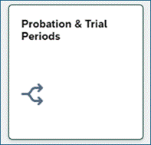
As a resource update, independent of the Reduction in Force process, we wanted to share that a new EBS tile has been released into production.
The tile is called 'Probation & Trial Periods'. It can be found in the 'Reports' section of EBS. The report will display regular Support Staff Employees who are in their probationary or Trial Period.
New EBS Tile: Probation & Trial Periods
As of the evening of March 18, 2026,Reporting Administrators may notice the availability of a 'Probation & Trial Periods' tile in the 'Reports' section in EBS.

Slide 11
Initiating a Budgetary Reduction in Force
For all budgetary reductions in force:
    The week of March 16, 2026, the Support Staff Layoff Team will email the MAU HR Lead to confirm that the reductions were approved.
    Based on the information confirmed by the unit, MSU HR will begin their layoff review.
    Please note: Probationary, Temporary and on-call (TOC) positions as well as student hourly positions do not have layoff provisions. Units may proceed with terminations based on business need.

Slide 12
Initiating a Budgetary Reduction in Force
MSU HR will contact the MAU HR representative if any additional information is needed before a determination on an impacted employee will be made.
The MAU HR representative will be the main contact for layoffs within an MAU or College and is responsible for coordinating with appropriate units and impacted employees through each aspect of the reduction in force process.

Slide 13
MSU HR Review and Approval
Once budget reduction related position impacts are confirmed with the MAU HR Representative the HR Analyst:
  Reviews unit checklist and spreadsheet information. The HR Analyst will request additional information if needed.
  Initiates seniority BI report to identify the appropriate employee(s) for layoff/reduction based on MSU Union Contracts layoff provisions and/or University’s Layoff Policy.
  Reviews unit probationary or temporary positions before proceeding with layoff determinations.
  Reviews layoff list with appropriate union leaders.

Slide 14
Issuing Notice of Layoff
  The HR analyst will notify the MAU HR Rep when an individual for layoff is identified and when the Unit should issue the notice.
    Notice MUST be issued on date of the letter, as notice dates impact the effective layoff date.
    The minimum contractual notice period begins the day after the notice was issued to the employee.
    If changes to issue date are needed, notify the HR analyst before discussing with the impacted employee.
  The HR analyst will complete a Leave of Absence (LOA) form via EBS workflow to place employee on layoff.
  The department must review and approve the LOA form in Workflow to acknowledge elimination of position.

Slide 15
Best Practices for Issuing a Notice
Units Should:
Use a private, neutral setting in which to deliver news. If the employee is remote on the day of notice, use the employee's usual communication method (Zoom, Teams, ETC.).
  Provide the written layoff notice at the start of the discussion to support the verbal conversation. This can be done via email if the discussion is occurring virtually.
  Avoid having conversations with an individual on Friday as employee resources will likely not be available.
  Make sure supervisors align their message to the direction of the unit/university leader. Be clear, empathetic, transparent, and be prepared for emotional responses. Remain factual but kind.

Slide 16
Best Practices for Issuing a Notice
Units Should (Continued) :
  Allow the employee to leave the building relatively privately if they wish to do so. Also provide the time for the employee to create an out of office message if they are being placed on paid administrative leave.
  MSU HR provides information to the unit to share with employee as the employee may not be able to receive the information verbally shared in meeting. Redirect the employee to MSU HR with any questions they may have regarding benefits, retirement, placement, etc.
  After providing notice, allow yourself and the employee space physically and psychologically after the conversation.

Slide 17
Best Practices for Issuing a Notice (con’t)
Units Should Not:
Do not escort the employee off the premises or out of the building.
Do not stop the employee from gathering their personal belongings.
Do not request the removal of non-unit specific employee access such as MSU Email. University access should remain throughout the layoff period.

Slide 18
Employee Out of Office Suggestion
“Hello, Thank you for your message. As of (DATE), I am no longer in this position at Michigan State University. Please direct any future correspondence to (supervisor or shared email inbox if applicable) at (EMAIL ADDRESS).”

Slide 19
Notice Periods
Union Group | Minimum Notice Period
APA & NURS | 60 calendar days
APSA | 60 calendar days
EXPA | 60 calendar days
CTU | 45 calendar days; plus 15 working days
AFSCME 1585 | 14 calendar days
SSTU | 14 calendar days
IUOE 324 | 7 calendar days
IATSE 274 | 60 calendar days
POAM | 21 calendar days
Non-Union | 60 calendar days

Slide 20
Administrative Leaves – Layoff Notice Period
There may be situations where the unit determines a need to place an employee on paid leave for the duration of layoff notice period.
During an administrative leave, the employee is compensated (salary, benefits, retirement, etc.) during the notice period but is not performing any work for the unit.
Units should work with the HR layoff team if an administrative leave is needed.

Slide 21
Accrual Payouts
Unused Vacation Accruals
  Employee may choose:
    A lump sum payout of their vacation accruals or
    Running out vacation accruals after their layoff notice period based on provisions of their collective bargaining agreement.
  HR staff will work with employee to explain accrual payout process.
Comp Time
  Unit will confirm if the impacted employee has unpaid comp time. If yes, the unit will submit a special pay form on the effective date of layoff to pay for any unpaid comp time.

Slide 22
Employee Payout
Final Paycheck and Accrual Payout
Paid on the employee's normal bi‑weekly or monthly payroll schedule
Issued after the employee's last day of work or after the employee's vacation time is fully exhausted
Payouts may take four to six weeks. When the payout is completed, the employee will be paid out on the normal bi-weekly or monthly pay schedule.

Slide 23
LTAP Payouts (APA and APSA only)
The department initiating the layoff is responsible for paying out Layoff Transition Adjustment Payment (LTAP)
    Applies ONLY to APA and APSA employees who have more than 6 years of University service and have been laid off for the minimum contractual amount of time (either 90 or 120 days depending on the union).
    Seniority dictates number of years that are awarded to the employee.
    LTAP = Annual Wage divided by 52 weeks, then multiplied by “weeks of pay” (seniority provision)
      HR will work with the MAU HR Rep to confirm LTAP calculation

Slide 24
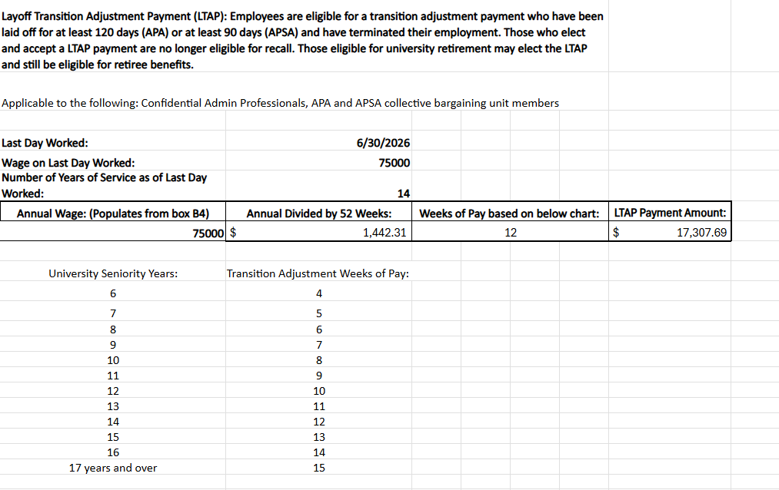
LTAP Payouts (con’t)

Slide 25
Benefit Impact of Vacation Time Run Out
  If employee elects to “run out” their vacation time, MSU's contributions towards benefits will remain active through end of the month in which they exhausted their vacation time.
  If employee elects to be paid out their vacation accruals in a lump sum, MSU's contributions towards benefits will terminate at end of the month in which employee was laid off.
  Contracts that permit employees to elect a vacation “run out” versus a lump-sum payout include APA, APSA, IATSE 274, and CTU

Slide 26
Layoff without Bumping Rights:
High Level Overview
Identify least senior individual according to the layoff provisions in the appropriate collective bargaining agreement.
APA and APSA employees on layoff may be eligible for mandatory bypass interviews when they apply to an open position in Page Up.
    To be considered a mandatory bypass interview, applicant must meet minimum qualifications, as determined by hiring unit for job posting in question.
POAM employees on layoff will be recalled into vacant positions before position can be posted.
The period of bypass / recall rights is equal to the employee's seniority at time of layoff or two years, whichever is lesser.

Slide 27
Layoff with Bumping Rights:
High Level Overview
The following contracts have negotiated bumping provisions: CTU, 1585,SSTU, 324.
MSU HR will identify least senior individual according to the layoff provisions in the appropriate collective bargaining agreement.
MSU HR will provide the unit with the layoff notice to be issued to the impacted employee(s).
    For SSTU, 1585, and 324 this layoff notice will also include information about subsequent bump(s)
HR analyst will meet with impacted employees to discuss bumping or bypass procedures.
For CTU layoffs; the HR Analyst will work with the impacted employee on bypass placement, while reviewing seniority reports for potential bumps.
    15 working days prior to the effective layoff date, MSU HR will issue bump notices to the bumper and subsequent bumpee(s).

Slide 28
Bumping Notices – High Level Overview
Bumping is when a more senior employee displaces the lowest senior employee within classification and level (depending on the contract provisions).
Bumping streams are dependent on layoff process identified in respective union contracts.
HR analyst verifies bumper meets minimum qualifications for position in question, in accordance with applicable contractual provisions.
HR analyst repeats the process of identifying next least senior employee until there are no bump options or the least senior employee is probationary.
HR analyst will notify department(s) being impacted by bump stream prior to the bump notice being issued to the employee.
HR analyst will issue bump notice to employee(s) being impacted by bump.

Slide 29
Layoff with Bumping Rights: Unit Preparation for Incoming Bumped Employee
Before the Employee Starts
  Prepare required equipment (laptop, system access, etc.)
  Review and provide the position description
  Develop a training plan
Upon Arrival
  Discuss position and unit expectations
  Clarify what success looks like in the role
  Initiate a goals discussion
Ongoing Considerations
  Bumped employees do not serve a trial, requalification, or probation period
  Performance issues should be addressed with Employee & Labor Relations
  Focus on the strengths and contributions that the incoming employee can bring to the unit.
  AVOID comparing the incoming employee to the employee they are bumping

Slide 30
Unemployment Information
Employees may qualify for unemployment during a layoff or following a separation from the University. Individuals can find information on how to apply for unemployment at: michigan.gov/uia.
Determination of benefits are done by the State of Michigan, Unemployment Insurance Agency and not by MSU.
Account and identification number information individuals may need to apply can be found in the Support Staff Policy & Procedure for Unemployment Compensation.
Further questions may be directed to Anne Czajkowski, Unemployment Coordinator, in Employee and Labor Relations at czajkow9@msu.edu and (517) 884-0103.

Slide 31
Form & Workflow Reminders
Academic and Support Staff Position request forms incorporate additional level of approval to the President’s Office, EVPA Office, Provost Office and Health Sciences Office.
Termination forms for all employment groups will provide a “budgetary” and newly added, "Federal/State Funding" reasons for termination actions.

Slide 32
Hiring Pause During Reduction in Force
The hiring pause will occur dependent on if the position being posted is in a union with or without bumping rights. The hiring pause will begin on Monday March 23,2026 and is expected to conclude at the end of June 2026.
Applies at the Time of Posting and/or Time of Offer
Positions in unions without bumping rights:
Unions without Bumping: AP, APSA, EXPA, 274, and POAM
Pause will only apply to units with position eliminations.
The pause will conclude at the end of the budget reductions.
Positions in unions with bumping rights:
Bumping Unions: CTU, 1585, SSTU, 324
  Central HR will review postings at time of hire in conjunction with the position eliminations across the University.
  The pause will conclude at the end of budget reductions.

Slide 33
Support Staff Virtual HR Office Hours
Week of March 23
    Tuesday, March 24, 3-4pm
    Wednesday, March 25, 11am – 12pm
    Thursday, March 26, 1-3pm
Week of March 30
    Monday, March 30, 10-11am
    Thursday, April 2, 2-3pm

Slide 34
Resources
Support Staff Layoff Resources: https://hr.msu.edu/ua/layoff-resources/
Budget and Layoff Considerations: https://hr.msu.edu/ua/layoff-resources/considerations.html
Budget Reduction Impacts on Workforce: https://hr.msu.edu/ua/budget-reduction-resources.html
Benefit Information for Support Staff Employees on Layoff: https://hr.msu.edu/layoff-resources/documents/Benefits-During-Layoff-Grid.pdf

Slide 35
Support Staff Questions:
SupportStaffLayoff@hr.msu.edu
FAS Questions: fasaffairs@msu.edu

